Slide 1
Huffman Coding

Slide 2

Huffman Coding
Huffman coding is a lossless data compression algorithm. The idea is to assign variable-length codes to input characters, lengths of the assigned codes are based on the frequencies of corresponding characters. The most frequent character gets the smallest code and the least frequent character gets the largest code.
Data Compression?

Slide 3
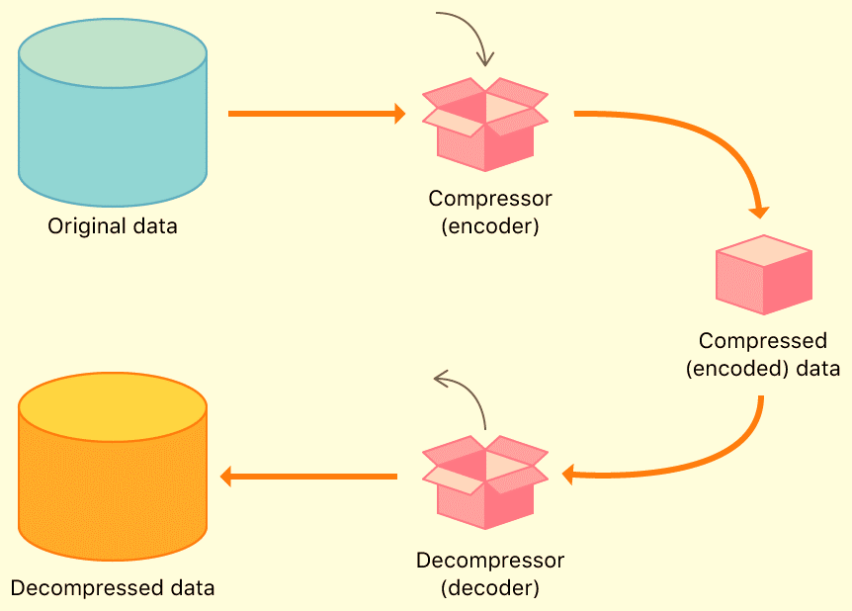
Data Compression:
Data compression is the process of encoding, restructuring or otherwise modifying data in order to reduce its size. Fundamentally, it involves re-encoding information using fewer bits than the original representation.

Slide 4
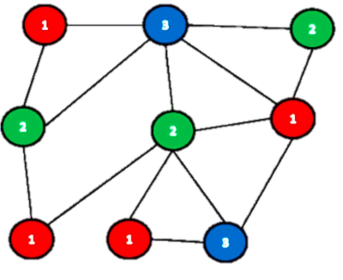
Introduction
It is a greedy technique
A greedy algorithm is an approach for solving a problem by selecting the best option available at the moment. It doesn't worry whether the current best result will bring the overall optimal result.
Used to encode data
Precisely used for Compression of Data

Slide 5
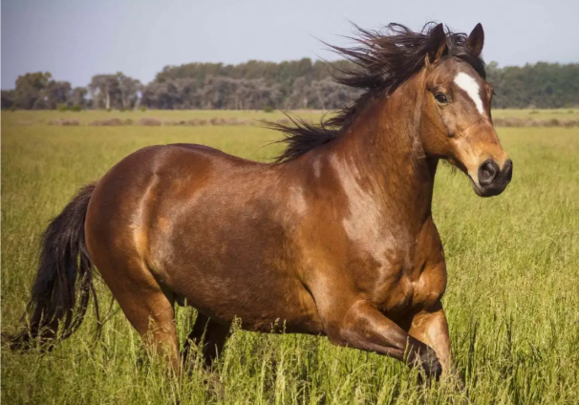
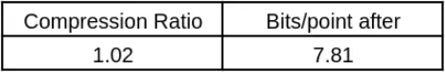
Example:
Horse Image with a diverse set of colors
This image has a broad range of colors.
It has many red pixels (in the horse), green pixels (in the grass), and blue pixels (in the sky).
This image may not be very compressible.
The results of the image compression with Huffman coding are shown below:
Results!

Slide 6
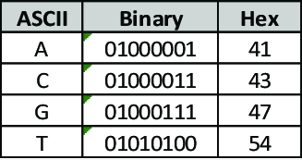
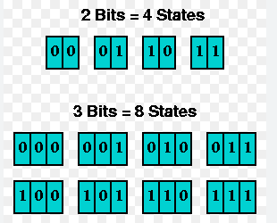
Various Encoding Techniques
01
ASCII
02
Number of bits

Slide 7
ASCII
We have 128 characters..(0->127)
We represent data using 7 bits.
I.e 2^7 =128
For example we represent “A” with which code?
We will represent it by 65.

Slide 8
Example
We have a message M=100
Words Frequency
a=30
b=40
c=10
d=20
Bits required to represent 1 Character?
7 Bits
Now for 100 characters ?
How many bits will be required?
100x7=700

Slide 9
Huffman Coding
Let's take previous problem statement
In huffman coding we select two word which is minimum in frequency.
For example in this example c and d has minimum frequency so select ‘C’. and ‘D’ and we will start making a tree in which min value will be on left and maximum on right .
And sum of these to will be our root node.
a=30
b=40
c=10
d=20
Total Length
100
30
C
D

Slide 10
Huffman Coding
Now 30 is minimum and we will find another character which is minimum.
‘a ’ has 30 frequency .
So
a=30
b=40
c=10
d=20
Total Length
100
60
A
30
C
D

Slide 11
Huffman Coding
Now 60 is minimum and we will find another character which is minimum.
‘b’ has 40 frequency .
So 60 will be on
Right and
B will be
On left.
a=30
b=40
c=10
d=20
Total Length
100
100
B
60
A
30
C
D

Slide 12
Huffman Coding
Now Start traversing and add 0 to left and 1 to right
100
0
1
B
60
0
1
A
30
0
1
C
D

Slide 13
Huffman Coding
Now Find Codes for each Character
Lets Start with a
a=10
100
0
1
B
60
0
1
A
30
0
1
C
D

Slide 14
Huffman Coding
Now b
a=10
b=0
100
0
1
B
60
0
1
A
30
0
1
C
D

Slide 15
Huffman Coding
Now c
Now c
a=10
b=0
c=110
100
0
1
B
60
0
1
A
30
0
1
C
D

Slide 16
Huffman Coding
Now d
Now d
a=10
b=0
c=110
d=111
100
0
1
B
60
0
1
A
30
0
1
C
D

Slide 17
Huffman Coding
Now Calculate number of Bits for each Character according to its frequency.
a=10 —--->2 bits now 2x frequency of a which is 30=60
b=0 —--->1 bit now 1x frequency of b which is 40=40
c=110 —--->3 bits now 3x frequency of c which is 10=30
d=111 —--->3 bits now 3x frequency of a which is 20=60
Total Bits required=60+40+30+60=190
As we can see in ASCII coding it was 700 Bits
And in Combination of Bits it was 300
Now it is 190
a=30
b=40
c=10
d=20
Total=100

Slide 18
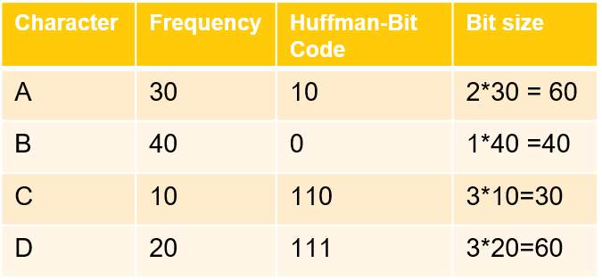
We have a message M=100
Now Calculate number of Bits for each Character according to its frequency.
Total Bits required=60+40+30+60=190
As we can see in ASCII coding it was 700 Bits Now it is 190 bits after encoding
a=30
b=40
c=10
d=20
Total=100

Slide 19
COMPLEXITY ANALYSIS
Time Complexity:
The time complexity of the Huffman algorithm is O(nlogn). Using a heap to store the weight of each tree, each iteration requires O(logn) time to determine the cheapest weight and insert the new weight. There are O(n) iterations, one for each item.
Space Complexity:
The tree contains k nodes. Space complexity is O(k) for the tree and O(n) for the decoded text.

Slide 20
Algo for Huffman Encoding
1 n ← |C|
2 Q ← C
3 for i ← 1 to n - 1 O(n)
4 do allocate a new node z
5 left[z] ← x ← Extract-Min (Q) O(logn))
6 right[z] ← y ← Extract-Min (Q) O(logn)
7 f [z] ← f [x] + f [y]
8 Insert (Q, z)
9 return Extract-Min(Q) t Return root of the tree.

Slide 21
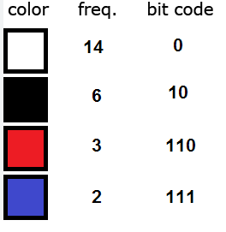
Applications:
Real-life applications of Huffman Encoding-
Huffman coding is based on the frequency of occurrence of a data item i.e. pixel in images. The technique is to use a lower number of bits to encode the data in to binary codes that occurs more frequently. It is used in JPEG files.
Huffman coding is used in conventional compression formats like GZIP, BZIP2, PKZIP, etc. For text and fax transmissions.

Slide 22
Thank YOU
☺

